Slide 1
Innovation, Monopolies, and the Poverty Trap
Jean-Marie Baland and Patrick Francois
Journal of Development Economics (1996)

Slide 2
Previous work
Industrial structure (whether a sector has a monopoly) affects incentives for innovation
Models of purposeful development of new technology in national growth
The conditions and implications of complementarities between individuals

Slide 3
This paper
Models the process of growth through technological disruption changing industry structure
When some sectors are monopolistic, returns on research are relatively high compared to production, even in unrelated industries
Characterizes initial conditions for multiple steady states and their transition paths
Welfare effects, potential for government intervention, and application for LDCs

Slide 4
Related to the Big Push (Endogenous growth literature)
Multiple steady states (including poverty trap) under certain conditions used to explain empirical differences is cross-country growth experiences
Increase labor productivity through investment (in technology rather than industrialization)
Government intervention strategies to escape poverty trap
Multiple sectors with spillover effects, particularly growth through creative destruction
Same use of Cobb-Douglas function with intermediate goods

Slide 5
Static model
One final good, y, produced competitively using a continuum of intermediate inputs
L identical consumers of y with 1 unit of inelastically supplied labor
Labor (l) , paid w, is the sole factor of both research and production of intermediate goods
Research is constant returns to scale and innovations arrive at rate determined by labor invested in research for sector i times a constant delta

Slide 6
Definitions
Industry Structure
Each sector can have (at most) one monopoly but some sectors don’t
Incumbent monopolies hold infinite patents on labor-saving technologies
Innovation
A firm invests labor to develop new technology
Increases labor productivity
Firm becomes new monopolist in sector through competitive advantage
New technology outmodes old technology, replacing incumbent with innovator

Slide 7
Competitive economy equilibrium
With perfect competition in every sector, and when costs of research exceed benefits, there is a unique equilibrium: y = w
Otherwise, there will be some amount of research
Labor market clearing condition
Gamma is constant representing increased productivity of new technology

Slide 8
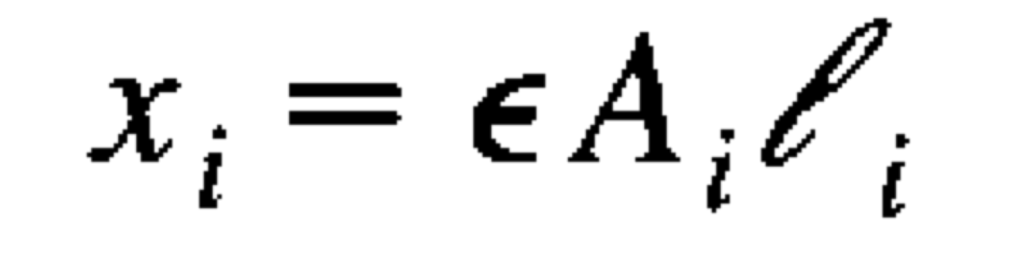
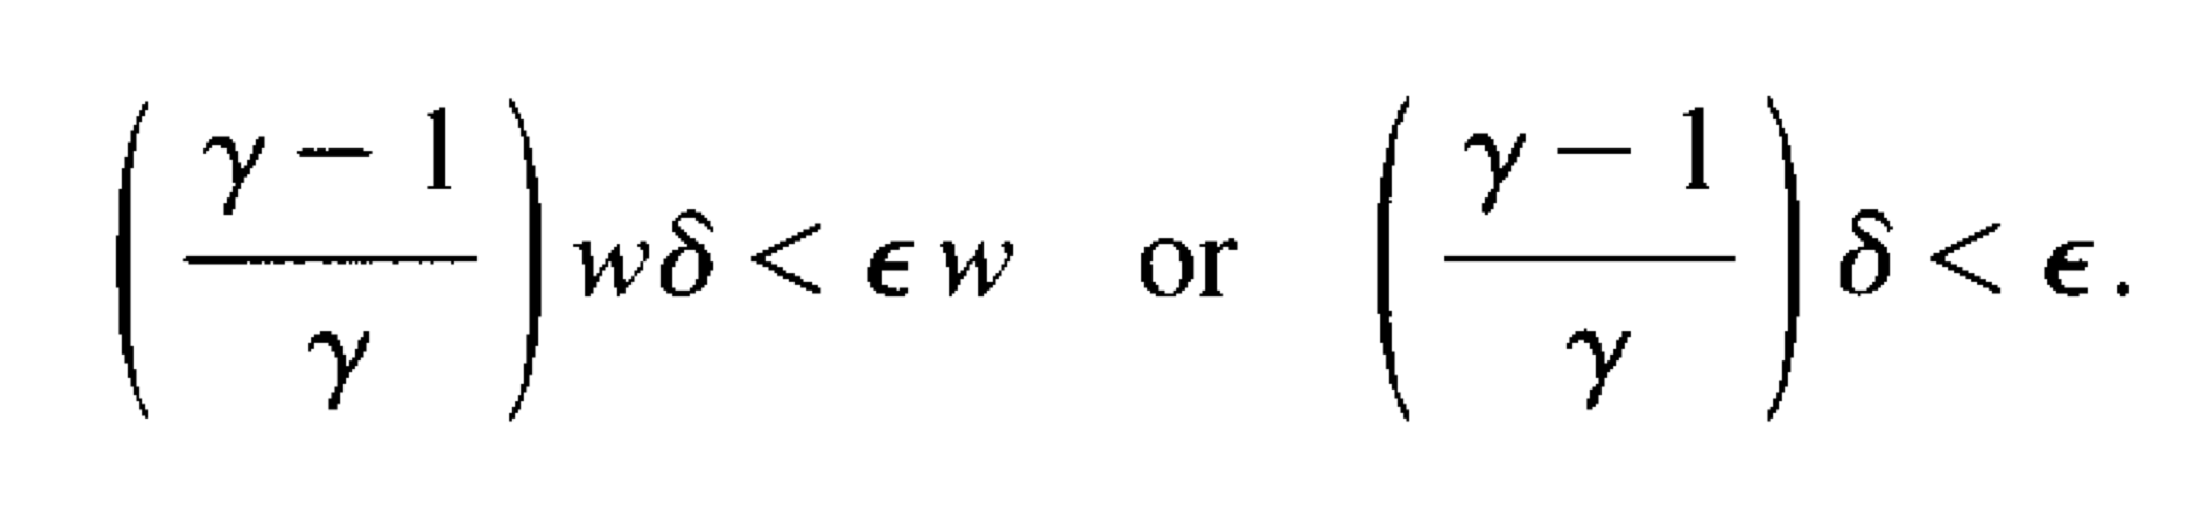
Monopolistic economy equilibrium
Modified production function:
Intermediate good x in sector i
Decreased productivity relative to the monopoly, epsilon
Now labor clearing implies y = w/epsilon which means the wage is relatively less when the economy initially contains monopolies
Relative to the competitive economy, labor’s share of total income is lower so the cost of research is lower in any one sector

Slide 9
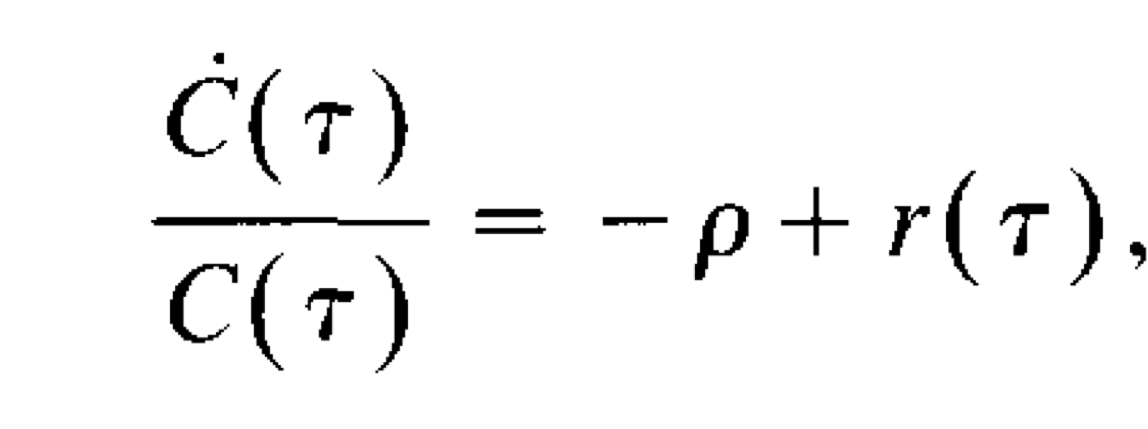
Dynamic model
First paper to endogenize industry structure in that some sectors are not monopolistic
The optimal consumption path combines the utility function, intertemporal budget constraint
Assume infinitely lived agents with unchanging preferences
Time tau with rate of time preference row and discount rate r
Assume Bertrand competition so profits are dissipated among firms with equal technology
Aggregate consumption (C) equals aggregate production (y)

Slide 10
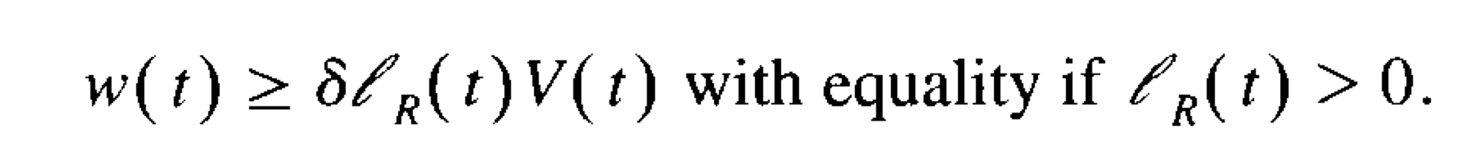
Research
Innovations arrive instantaneously and increase labor productivity by factor (gamma) relative to incumbent for innovator
Patents protect incumbent and provides flow of profits of value V(t) until new innovation
Since research effort and innovation value is distributed evenly, at equilibrium:

Slide 11
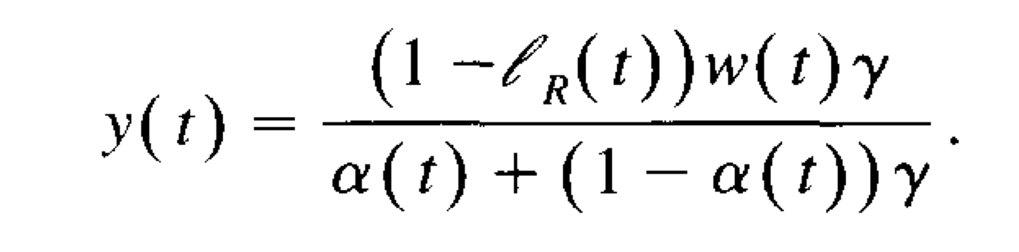
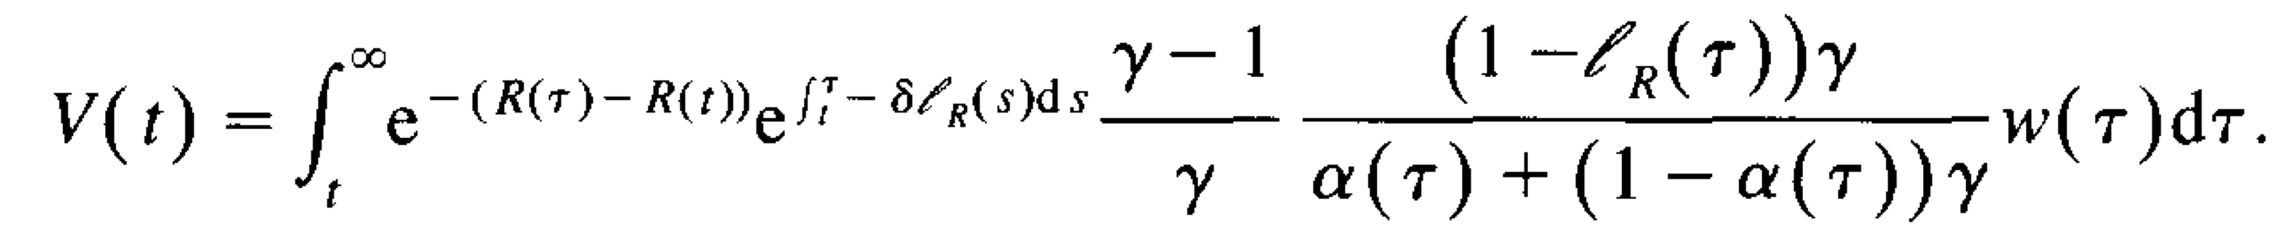
Instantaneous equilibrium
With alpha(t) denoting the proportion of sectors dominated by a monopolist, labor market clearing implies (26)
Note that wage relative to output decreases in alpha
As a result, the flow of profits from innovating to a new monopolist equals:
Within the integral is
(discount rate)*Pr(displacement)*(monopolist’s markup)*(inverse of labor’s share of income)*(wage)

Slide 12
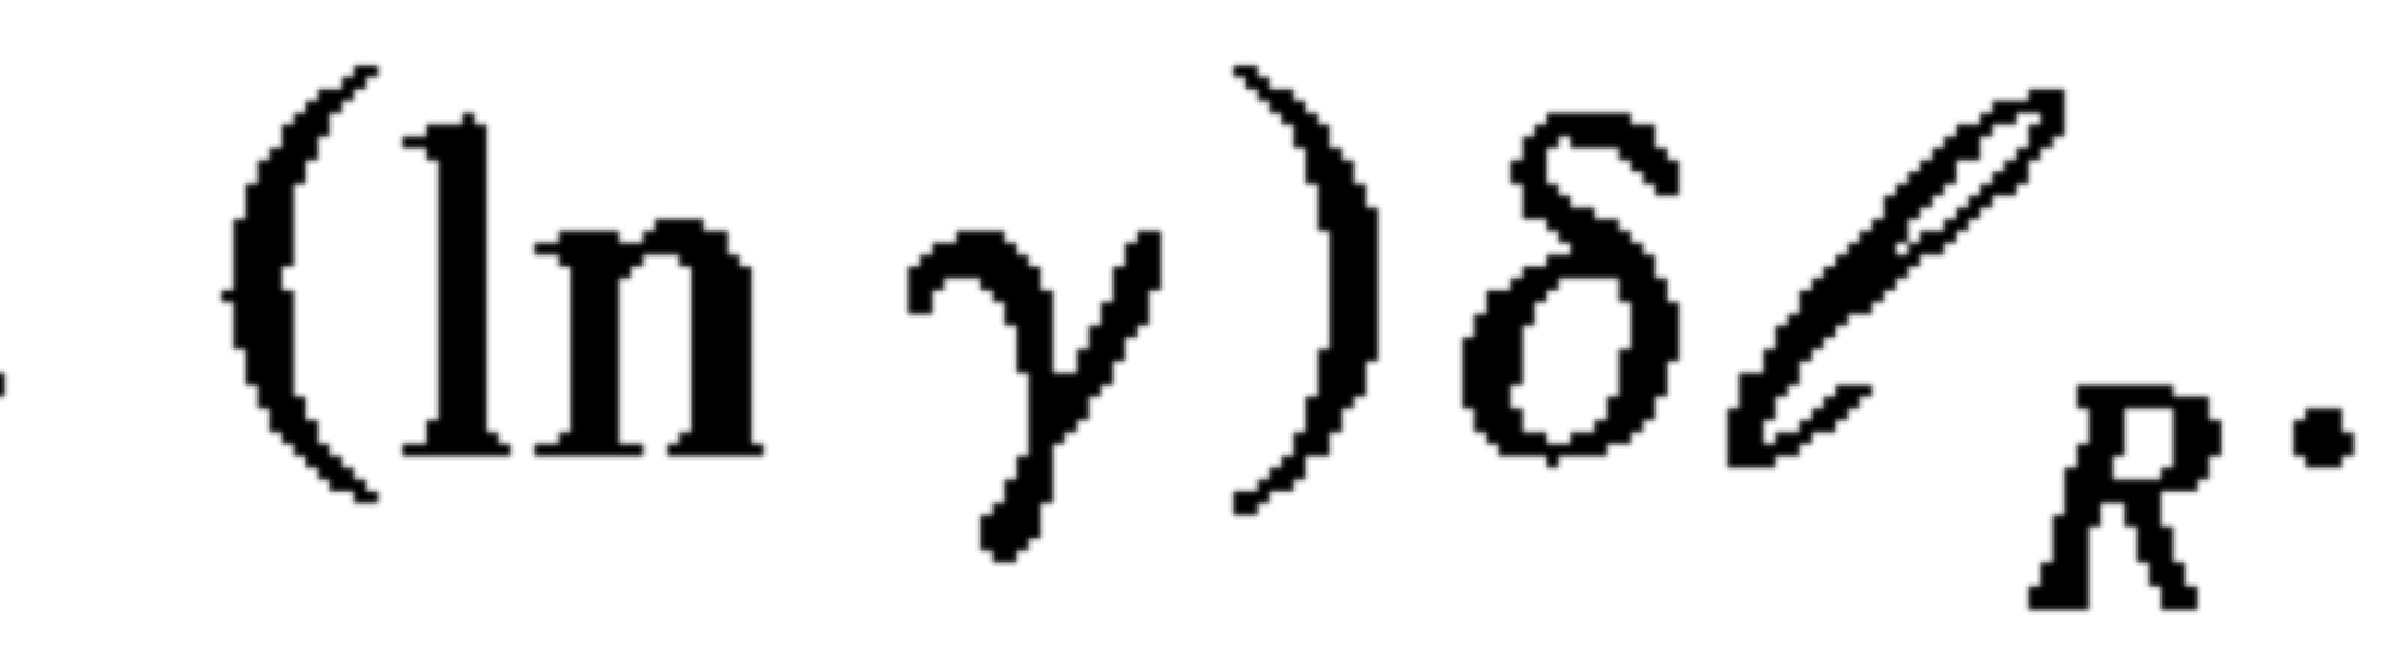
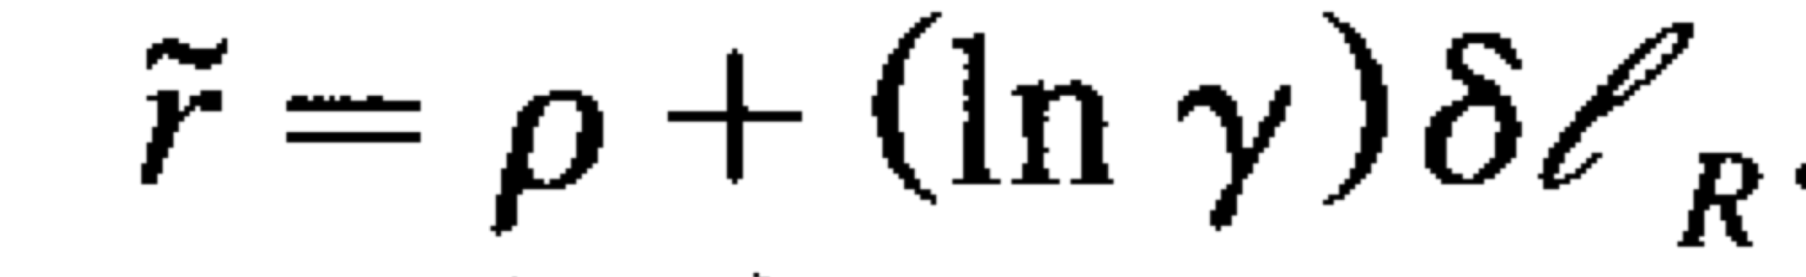
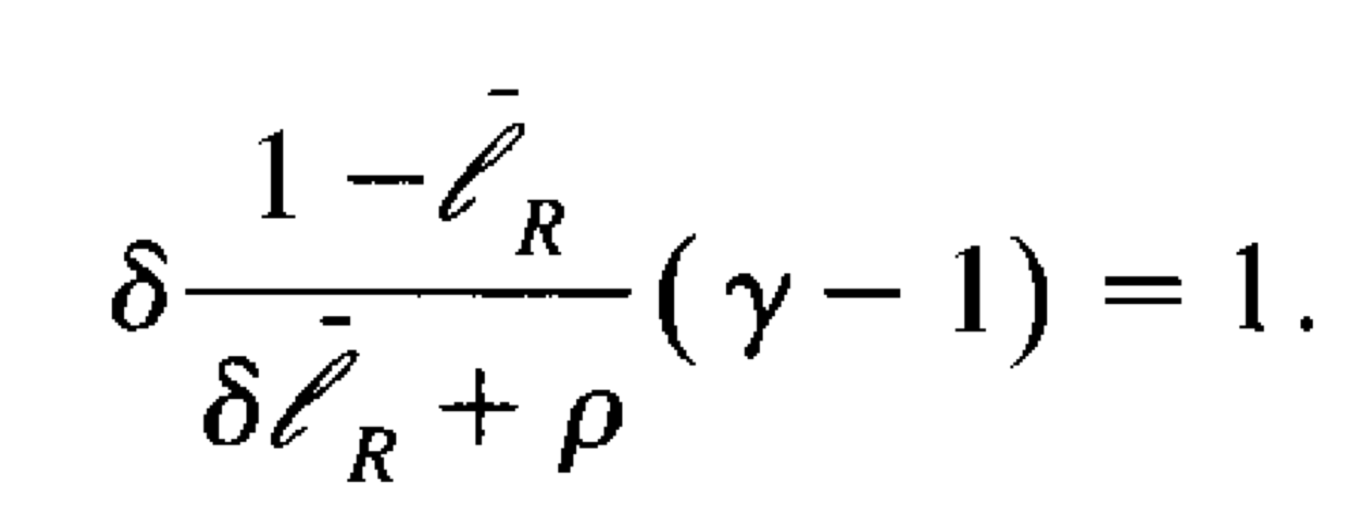
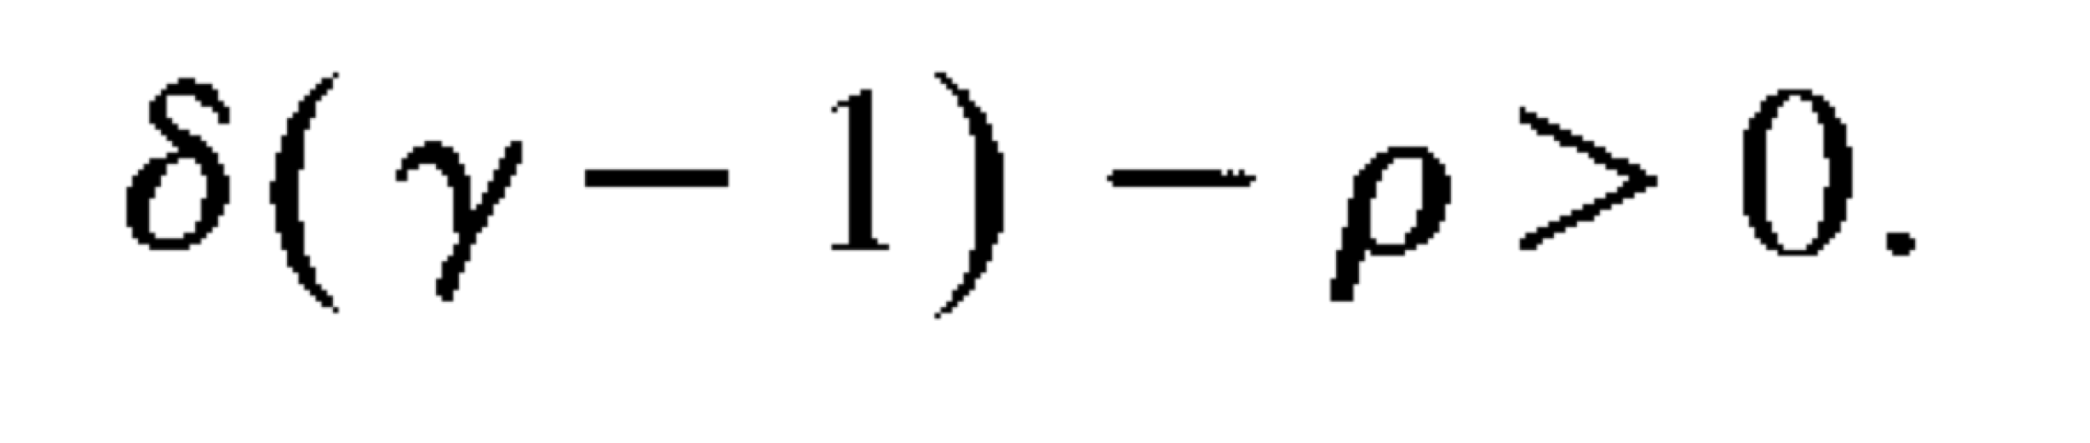
Steady state with positive research
Steady state/Equilibrium: stable allocation of labor between research and production
There is only research if all industries have monopolists with a technological advantage
Wage and output grow at constant rate,
With interest rate,
Solutions for research labor imply unique equilibrium
Steady growth when

Slide 13
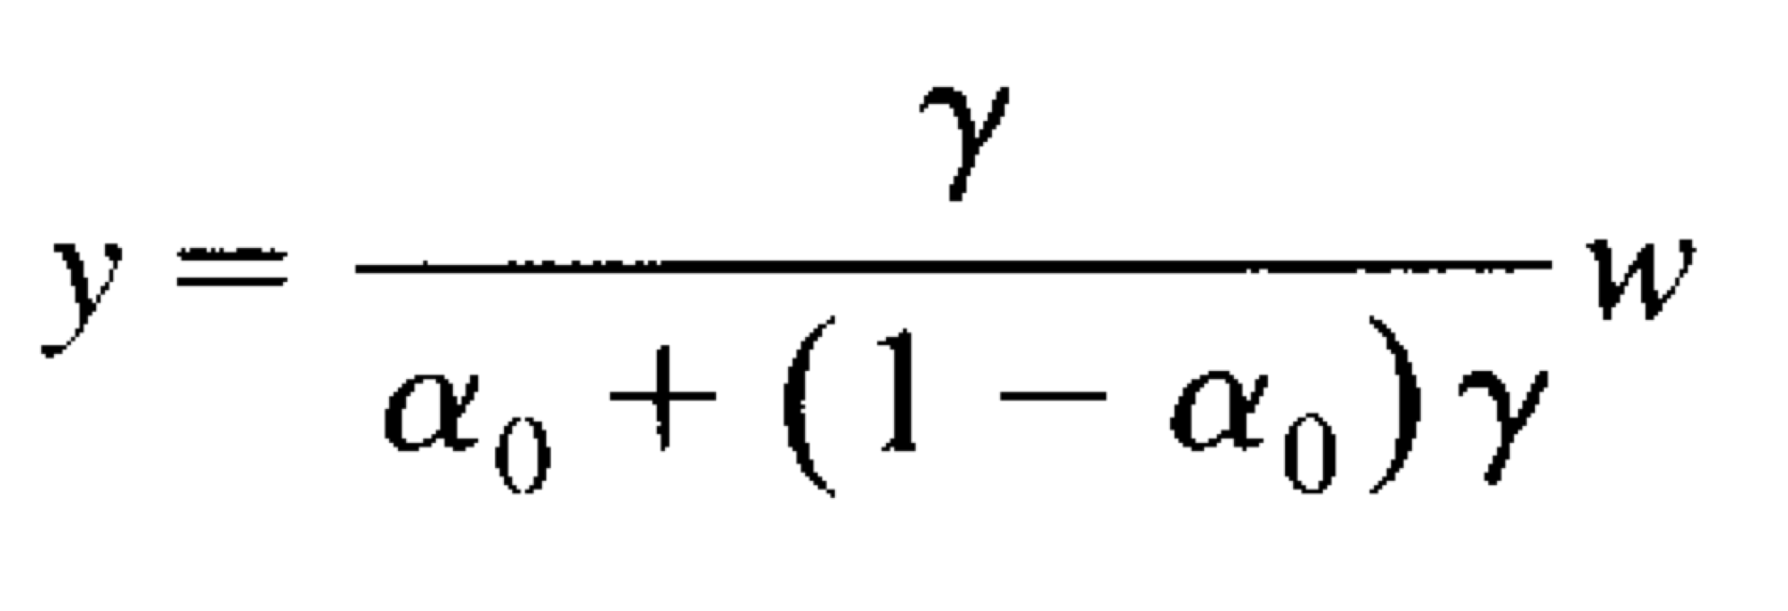
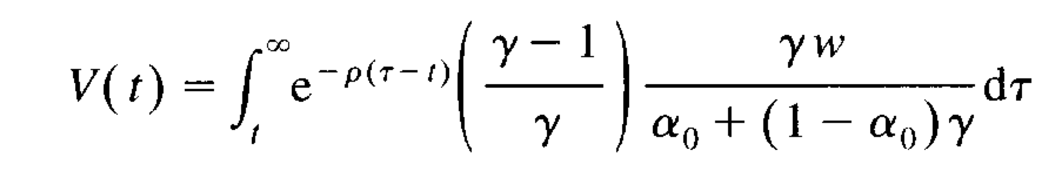
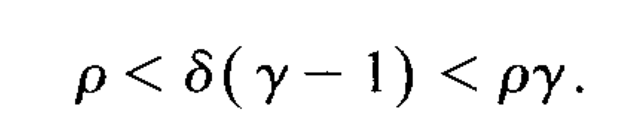
Steady state with no research
As long as total wages exceed total value of innovation, no growth implies the following expressions for output and innovation value:
These means that both steady states of sustained growth and growth trap exist when
In other words, initial industrial structure may determine the steady state
With multiple paths of transition, sufficiently optimistic expectations )row) can create a Big Push

Slide 14
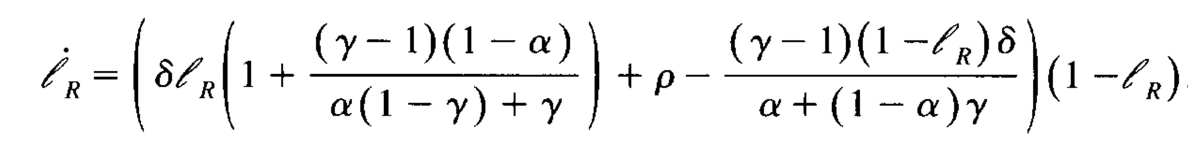
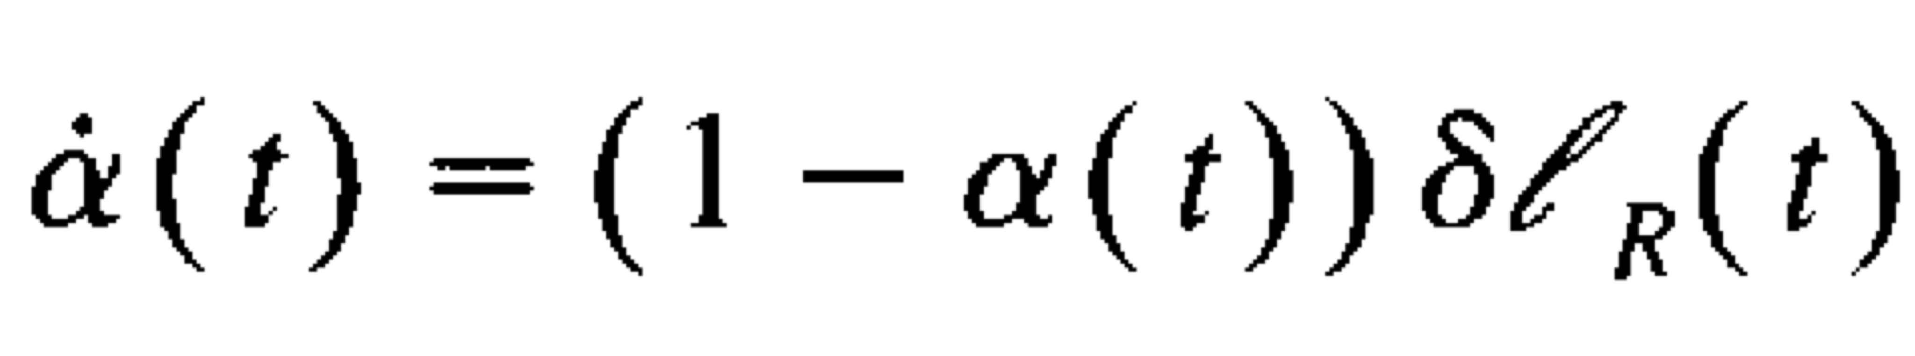
Dynamics
Moving from the growth trap to sustained growth depends on the motion of the proportion of monopolistic industries (alpha) and research effort ( l_{R}(t) )
There exists a saddle path nearby the steady state with sustained growth
For any alpha, levels of research above a threshold value of research effort (l_{R} bar) imply an increase until all labor is applied towards research

Slide 15
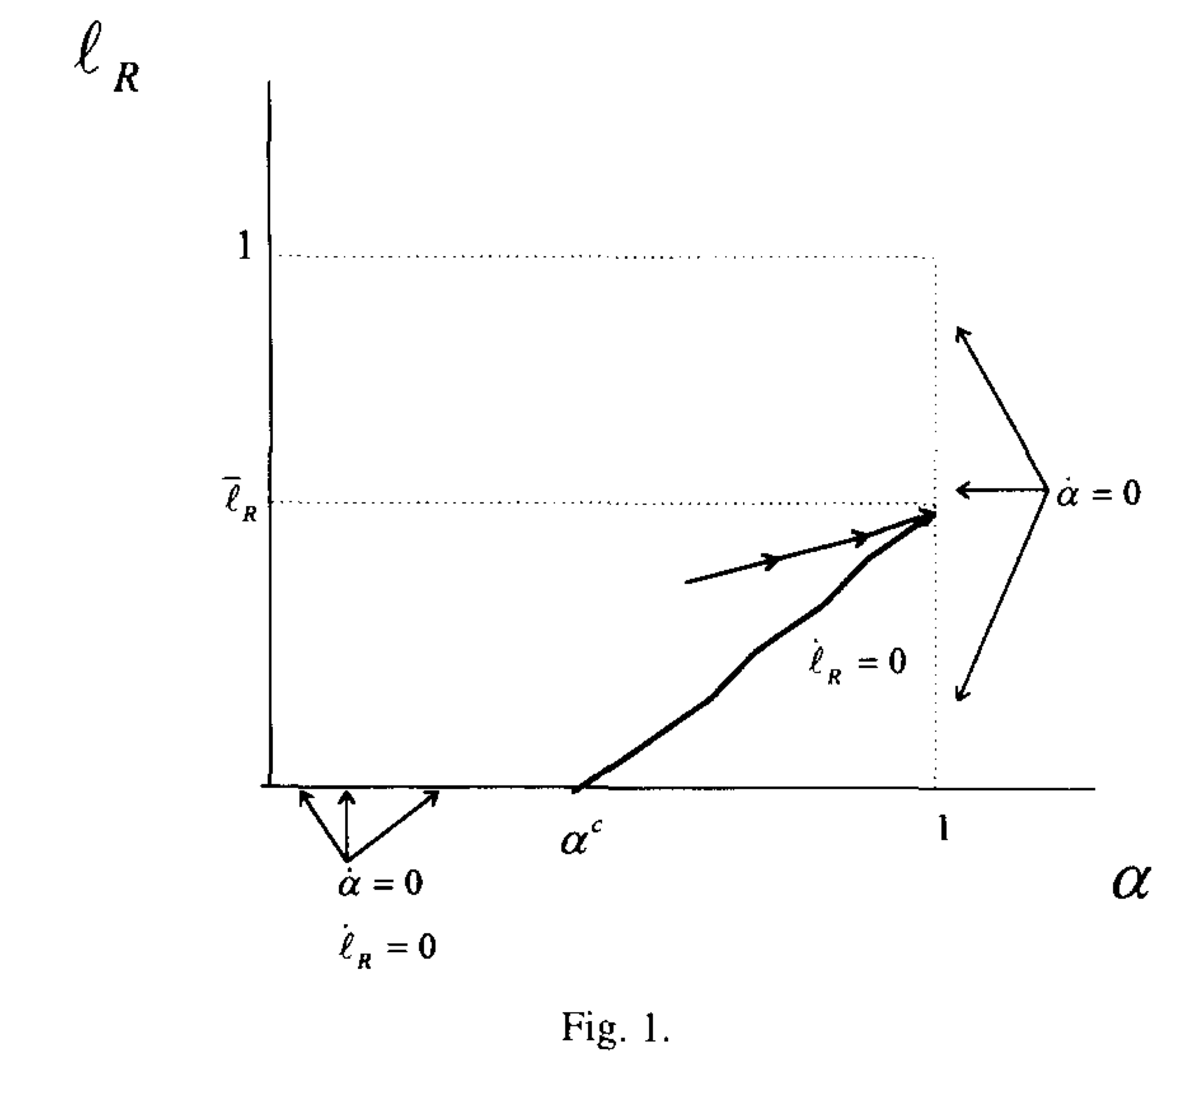
Saddle path

Slide 16
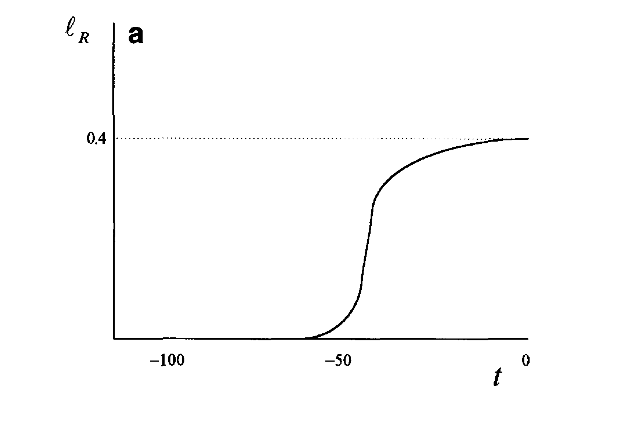
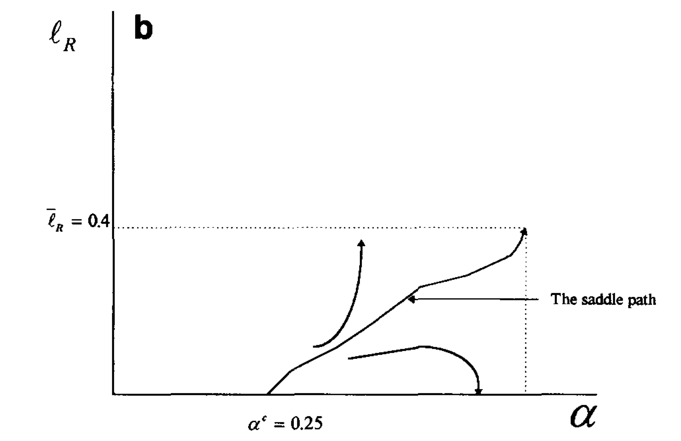
Saddle path example
When row=0.8, gamma=3, l_{R} bar = 0.4, and alpha^{c} = 0.25 to satisfy condition of two steady states

Slide 17
Dynamics cont.
Simulations for parameter values including levels of monopolist markup show alpha must initially exceed a threshold value for the economy to escape its growth trap
Otherwise even optimistic expectations are insufficient
Research labor is not complementary between industries
The rush of research effort only lowers returns to innovation
Expectations are not fulfilled

Slide 18
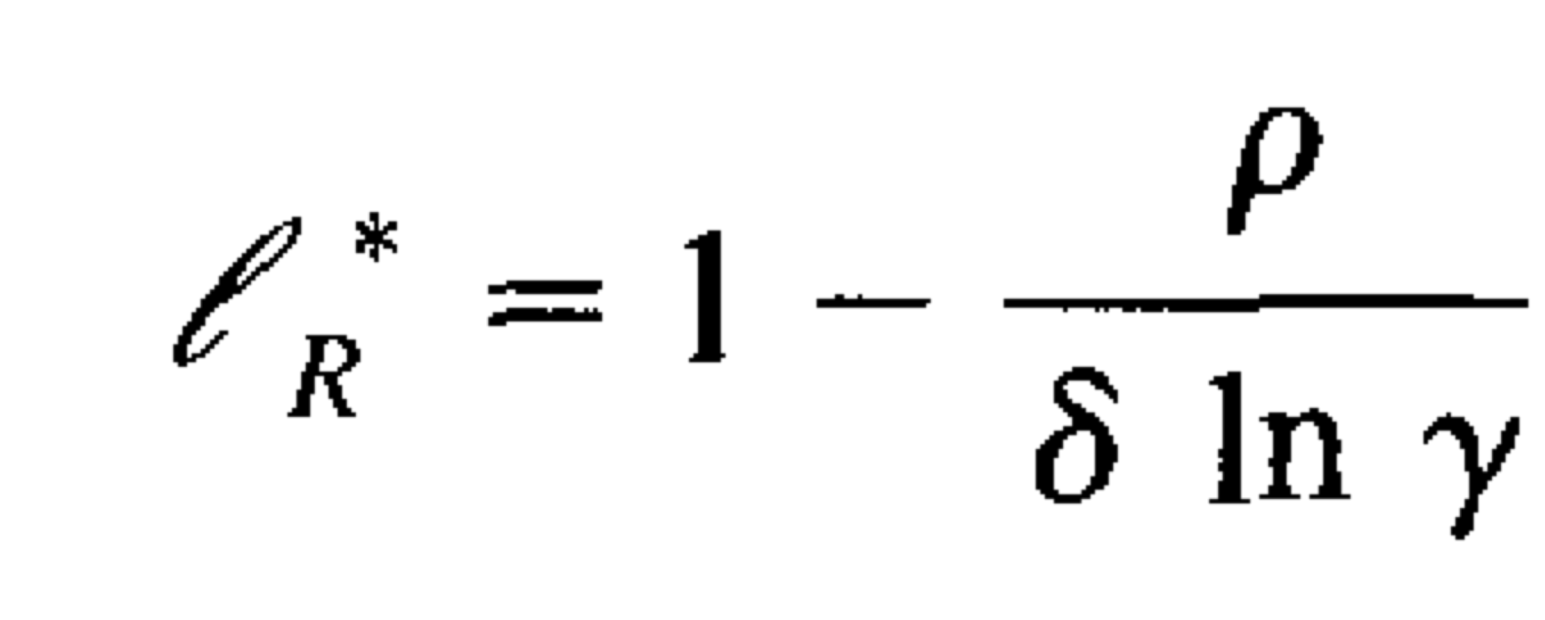
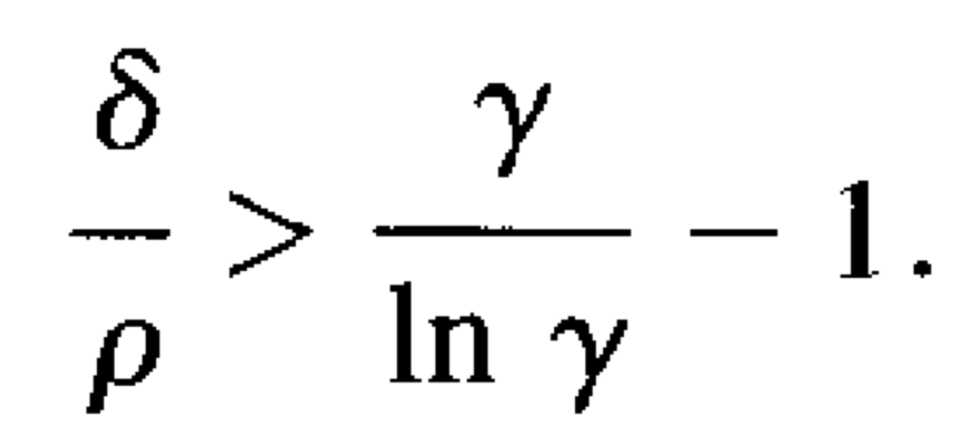
Properties of the optimal path
Based on even allocation and constraint of total labor, as well as no storage, dynamic optimization yields
Actual investment in the steady state with growth doesn’t meet this socially optimal level of research when

Slide 19
Government subsidies
If both steady states exist and the state with growth has less than socially optimal research
Assume alpha is just below threshold level: alpha₀
Research subsidy S creates incentive to allocate research to labor in following periods
Research increases monotonically in all periods, converging to steady state with growth
In particular, every industry allocates a socially preferred level of research
The subsidy is constructed arbitrarily small so it constitutes a pareto improvement

Slide 20
Government research
Public research is qualitatively equivalent to subsidy if the government acts as a monopolist
If the research is not public available, the proportion of industries can increase past critical level
Otherwise, government research crowds out and disincentivizes private research
Alpha falls and wages rise relative to private returns to research
Aggregate research falls, lowering growth, sometimes to the poverty trap

Slide 21
Entrepreneurship: application for LDCs
Limited growth in LDCs is not likely constrained by R&D investment (technological invention)
Research can be interpreted as the implementation of superior production methods
Research effort can be interpreted as entrepreneurial activity assuming no required skills
Lower marginal cost constitutes a competitive advantage and limit pricing displaces competitors
Without patent protection, production methods can be imitated, but likely won’t because the cost or likelihood of failure yields no profit in Bertrand competition with incumbent
Therefore, entrepreneurship in one sector displaces traditional producers to others, making entrepreneurship relatively more worthwhile (much like Murphy et al)

Slide 22
Human capital requirements
Entrepreneurship might require particular skills that are not uniformly distributed
Define a second factor of production in all sectors: h
No effect on qualitative results of previous analysis
Again, two steady states exist under similar initial conditions
Once a critical number of sectors are modernized by entrepreneurs, the economy converges to sustained growth
Traditional production is no longer attractive relative to entrepreneurial risk

Slide 23
Conclusion
This paper provides a mechanism for the trend, noted in previous literature, of monopolist rents incentizing capitalist innovation and growth
Monopolies increase the share of profits in aggregate income, lowering real wage, and increasing the relative profitability of investing labor in research
Under particular initial conditions, there exist multiple states states
The level of competition determines the transition from zero growth to sustained growth, potentially aided by government intervention that encourages monopolization

Slide 24
Critique
It is unlikely that a industry structure changes so dramatically and consistently
The rent of an industry is small relative to licensing truly valuable technology
Effective R&D isn’t a random process but rather compounds on expertise and experience
Mitigating decreasing marginal productivity requires increased human capital rather than homogenous labor
An industry might be geographically dispersed and difficult to completely disrupt
Innovative research would be constrained by capital and not just labor
There are large fixed costs to developing new technology
Innovation incorporates old technology so increased labor productivity would likely be marginal and not completely displace the incumbent

Slide 25
Critique
There are several critical, but unjustified, assumptions
Bernout competition for any industrial structure
Equally distributed labor allocation
Positive marginal returns to research in all time periods
Other arguments are unclear
How can an innovator assemble labor for research when the incumbent dominates the industry?
How does public research change industrial structure if it is not publically available?
The level of abstraction removes most empirical application, especially with the emphasis on initial conditions of competitiveness

